Slide 1
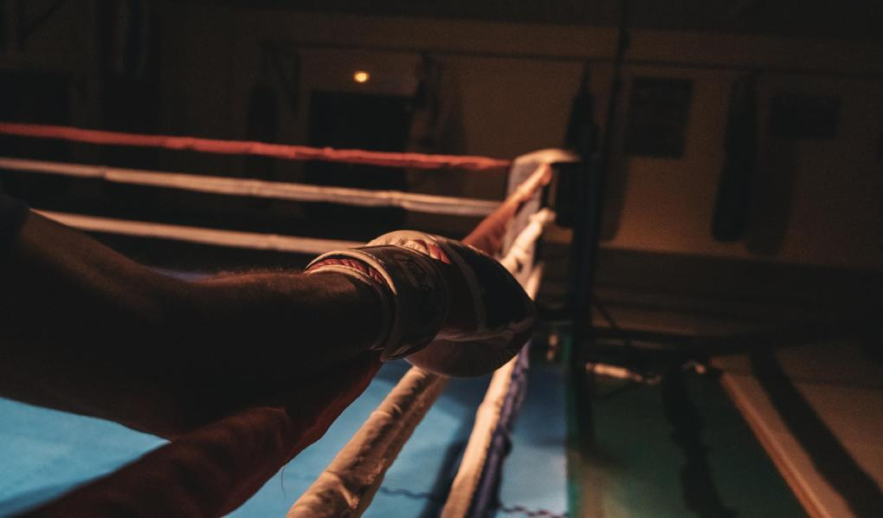

2 0 2 5

Slide 2
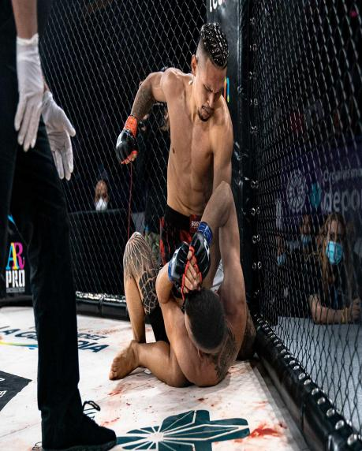


PUNCH TV
Punch TV is a premium Pay TV channel specializing in combat sports, including MMA, kickboxing, boxing, professional wrestling, Muay Thai, and more.
The channel broadcasts licensed fights from international LIVE championships, along with exclusive programs showcasing the best moments from each season.
Designed for those who believe in the power of combat sports, Punch TV aims to inspire while also promoting key values such as discipline, perseverance, and determination.
T H E C H A N N E L

Slide 3


+ 20 years of experience in combat sports
70 live events per year
O U R C O N T E N T
400 hours of fresh content annually
global brands partnerships

Slide 4

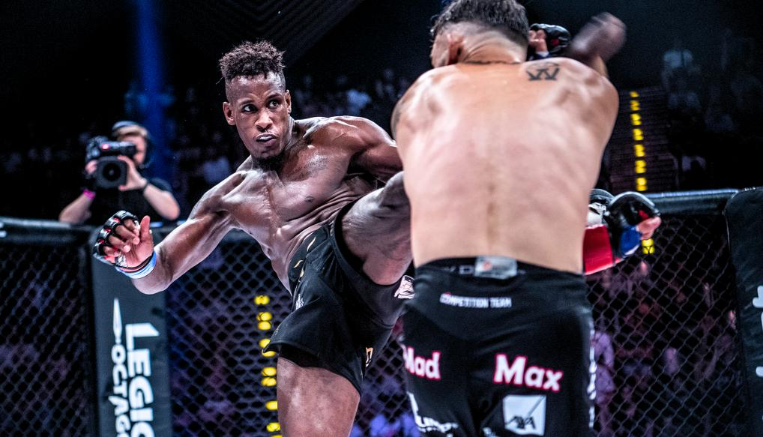
DELIVERY METHOD
The channel can be broadcast via IP using protocols such as Zixi, RTMP, SRT, or others. Satellite broadcasting is available upon request.
With content tailored to each major region of the world, the channel's programming consists of 80% international content and 20% local promotions and fighters.

Slide 5

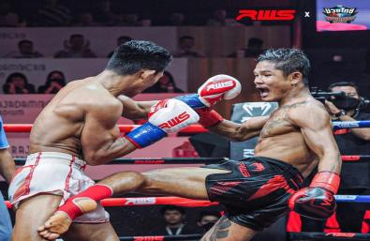

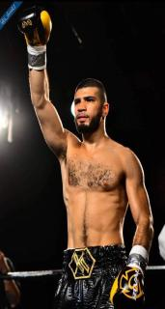
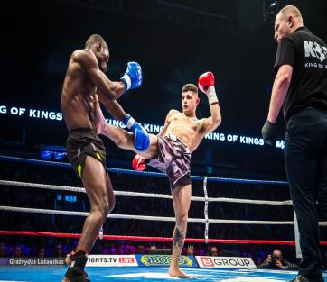
PREMIUM CONTENT
Punch TV has an exclusive partnership with Fighting Spirit, the leading distributor of combat sports for television since 2004.
Through this strategic collaboration, Punch TV is committed to delivering captivating and entertaining content to a global audience. This partnership reflects Punch TV’s unwavering dedication to providing viewers with the highest-quality viewing experience.

Slide 6


PROGRAMMING
mma
muay thai
mma
HEXAGONE MMA
RWS
COMBATE GLOBAL
Hexagone MMA continues its rapid expansion in 2025, reaching over 100 million households worldwide. This year, + 15 LIVE events are scheduled across key cities in Europe, reinforcing the organisation’s growing footprint on the continent. Each event airs in European prime time, lasting 2h30 to 3 hours of premium MMA action.
RWS is booming, with audience numbers up 260% — a clear sign of Muay Thai’s growing global appeal. The promotion is gaining strong international recognition, attracting new fans and solidifying its place as a major player in the combat sports scene.
Focused on the Hispanic market, Combate Global continues its strong momentum in 2025. Ranked by Forbes in 2024 as one of the world’s top 10 most valuable combat sports organizations, it now hosts over 30 events annually and holds a solid position in the U.S. MMA landscape.

Slide 7
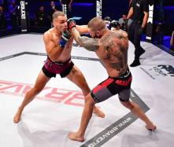
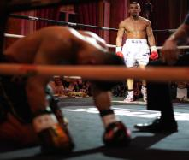
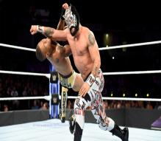
PROGRAMMING
mma
boxing
wrestling
BRACE CF
PREMIUM BOXING
MLW WRESTLING
From South America to Asia and Africa, Brave CF is an organization deeply connected to its international community. The organization has established a presence across the globe, visiting over 30 countries in the past three years, demonstrating its strong commitment to MMA.
Punch TV delivers a rich lineup of boxing events, featuring top-tier international titles and European championships that draw talent from across the globe. Through carefully selected organizations, it offers a global stage that highlights boxing at its highest level.
Founded in 2002 by Court Bauer, MLW blends various wrestling styles, including British Strong Style, Catch Wrestling, Hardcore Wrestling, Lucha Libre, MMA, and Hoot Wrestling. This unique combination provides fans with an exciting experience while preserving the heritage of wrestling and fostering the rise of new talent.

Slide 8
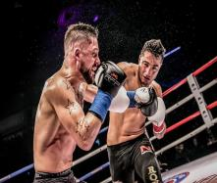
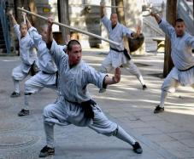
PROGRAMMING
kick boxing
taped mma
documentary
ENFUSION
FIGHTING SPIRIT MMA
MARTIAL ARTS CHRONICLES
Enfusion is a leading combat sports organization renowned for its electrifying events featuring top-tier fighters in kickboxing. With a commitment to showcasing international talent, Enfusion highlights the excitement of combat sports while promoting values of discipline and sportsmanship within the martial arts community.
Fighting Spirit MMA is a dynamic program featuring 8 seasons with 52 episodes each, currently in production for season 9, set to air in 2025. The show highlights the best KOs and TKOs from various organizations, showcasing thrilling moments that celebrate the excitement of mixed martial arts.
Martial Arts Chronicles is a comprehensive resource for enthusiasts, covering various disciplines and the latest trends in martial arts. Offering insights into techniques, training, and competition, it serves as a hub for practitioners and fans alike, celebrating the rich history and culture of martial arts around the world.

Slide 9
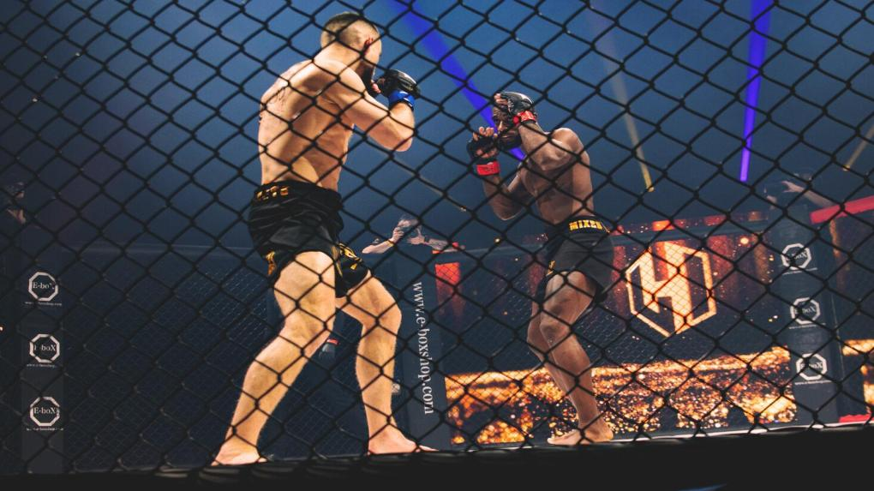
A LOCALIZED CHANNEL
PUNCH TV is an international combat sports channel that puts the spotlight on local talent, tournaments, and stories from the regions where it’s broadcast.
By focusing on fighters, commentators, and events from these areas, PUNCH TV offers fans a unique chance to cheer for their own heroes while enjoying top-tier action from around the world.
From regional championships to global showdowns, PUNCH TV delivers dynamic, exclusive coverage tailored to the passions of each local audience.

Slide 10
